Slide 1


Slide 2

Overview
Microsoft want to venture in movie industry but want an overview of key factors to consider to enable them make a decision.

Slide 3

KEY FINDINGS
Keys findings in the analyses will be based on the below
1 ROI and production budget
2. Most profitable genre
3. Publishers and Rating

Slide 4
SOURCES
I used data from:
The Numbers Movie Budgets
TMD
Box Office Mojo

Slide 5
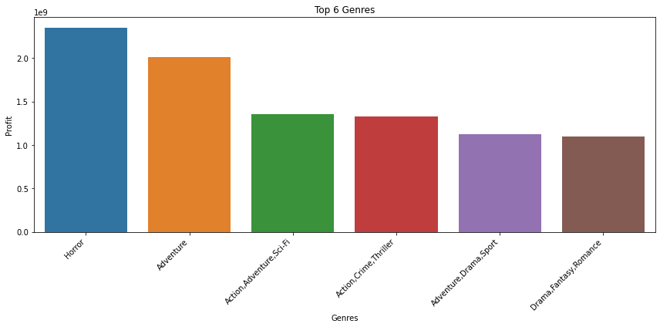
Analysis
Analyzed the correlationship between production budget and domestic gross, most profitable genre, and most popular genre

Slide 6
CONCLUSION
Below are my findings from my alaysis above;
1.The production budget plays a major role for profitability in the film industries . this may be attributed to major factors like marketing marketing cost, investing in popular movie actors and directors which come at a higher cost, language interpretation of the original film etc.
2.Horror movies are the most profitable in the film industry but we have noted that movies that falls under more than one genre are more profitable too.
3.Popularity of a film doesn't guarantee the profitability of the film. From our analysis, there are some genres that were very popular in terms of vote counts but the profitability was lightly lower.
4. We also noted that a strong positive correlation between domestic gross and worldwide gross. this means that is a movie dose well in the local market, it will also perform well in the international market.

Slide 7
Recomendations
1.Consider good budget allocation for film production as we have noted that there is strong positive correlation between production budget and both domestic_gross and worlwide_gross as this will enable you have good marketers, best producers and also renown movie actors which will make the film production a success and popular hence more profitability.
2.Divesify the genres to maximize profitability. In as much as horror movies are the most profitable, we have seen other film that have a mixture of different genres being proftable too.
3.The runtime minutes for films is averagely between 90 - 150 minutes, therefore if there's a probability of having a longer film, it's best to create them in series of between 90 - 150 minutes.
4.Forcus on marketing the films in the domestic market as this will determine the success/ profitability of the film in the international markets. As noted in our analysis, there was a strong positive correaltinship between domestic_gross and wolrwide _gross
5.. Consider the overall market trend and consumer preferences when making investment decisions in the movie industry. For example, if streaming services are becoming more popular, short documentary film is a good genre to forcus on as they have the potential to perform well on streaming platforms. Keeping up with the latest market trends can help make informed investment decisions.

Slide 8
THANK YOU

